Slide 1

“Nito” UI Design Presentation
Course-Section: CS102-03
Group: 3B
Group name: Internationals
Group members:
Ziya Mukhtarov, Javid Baghirov, Mokhlaroyim Raupova, Adeem Adil Khatri, Alper Sari, Mannan Abdul
Assistant: Mehmet Başaran
Notes:
Mohi

Slide 2
Outline
Re-introduction of “Nito”
Examinee Interface
Administrator Interface: Main Window
Administrator Interface: Monitoring
Administrator Interface: Grading
Q&A
Suggestions
Notes:
Mohi

Slide 3
Re-introduction of “Nito”
“Nito” is an exam system that aims to reduce the stress exam process brings to both examinees and examiners.
It features safe and simple interfaces for creating, conducting and grading mainly Computer Science/Engineering exams
Notes:
Mohi

Slide 4
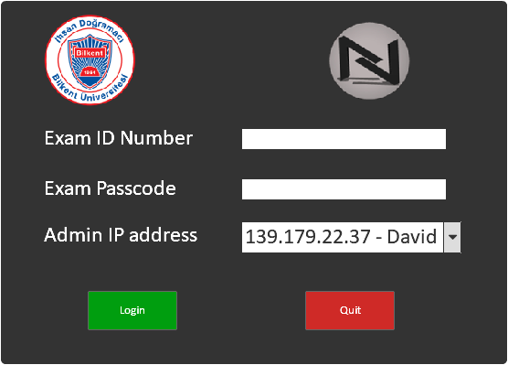
Examinee Interface Login
Examinees input their ID, exam passcode and choose the IP address (title) of their administrator to enter the exam
Notes:
Alper

Slide 5
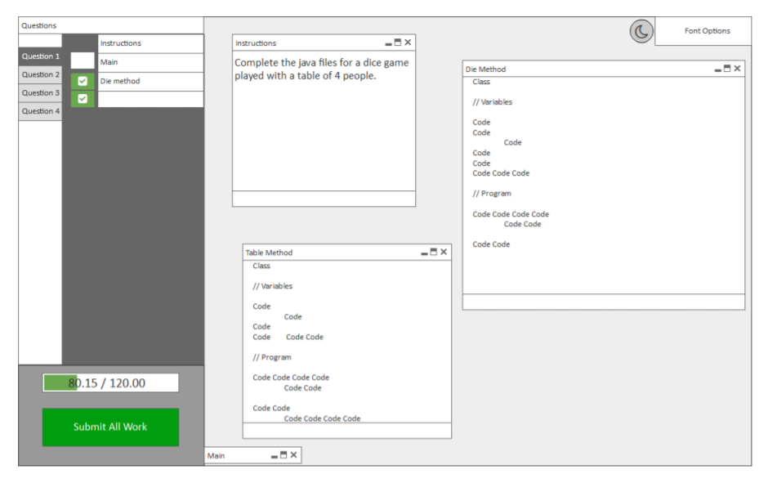
Examinee Interface Main View
Fullscreen interface
Multiple windows that can be minimized
Timer
Completed questions can be ticked off on the checklist
The font and the theme can be changed too
Notes:
Alper

Slide 6
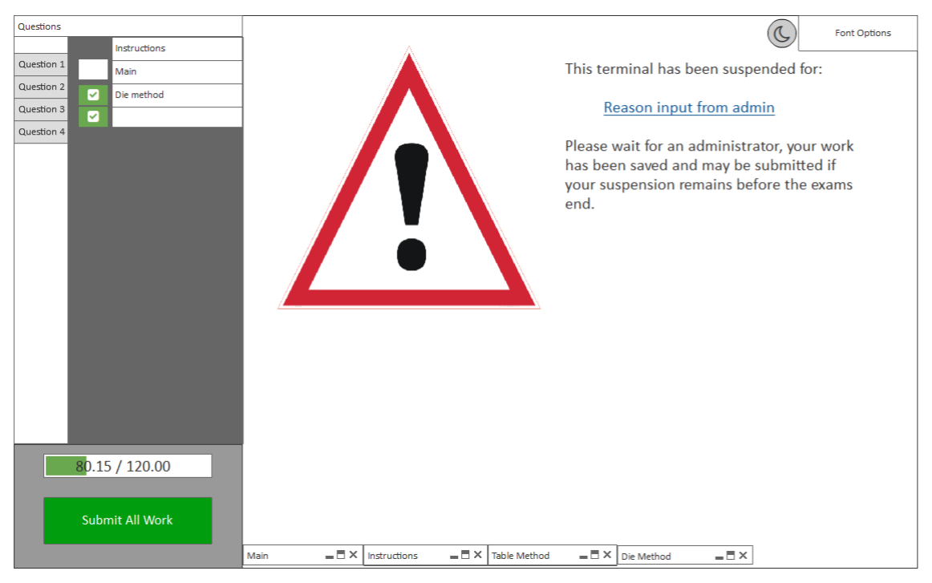
Examinee Interface Suspension
Examinee gets blocked and cannot edit or see their work.
Suspension is removable by admin.
Only submission is possible during the suspension.
Examinee receives a notification from the admin.
Notes:
Alper

Slide 7
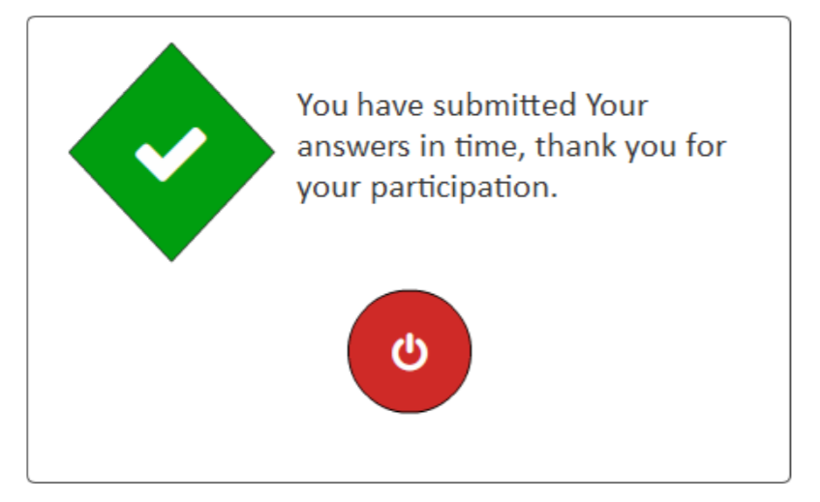
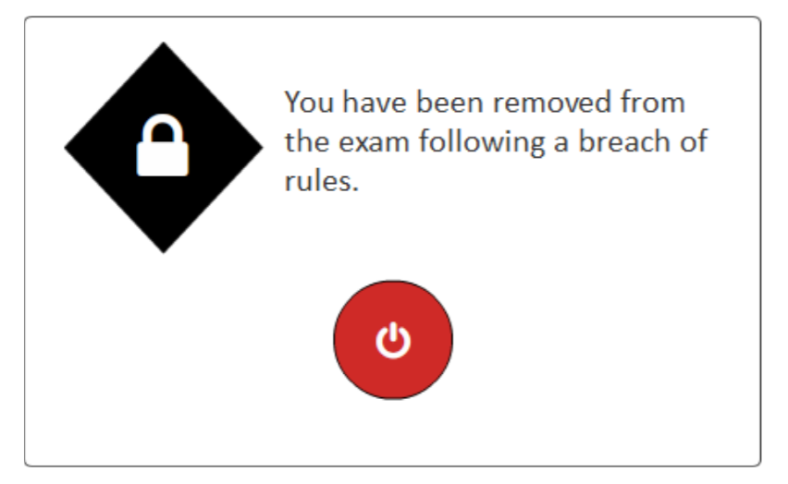
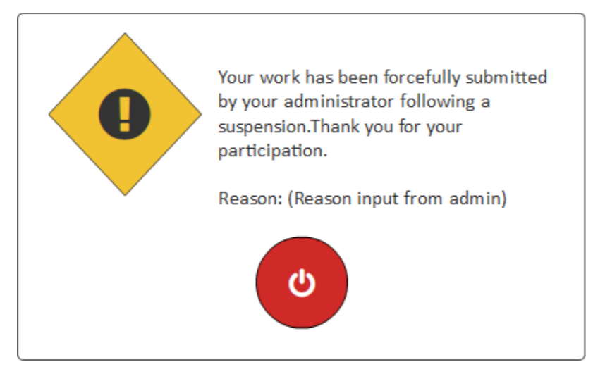
Examinee Interface Ending Windows
There are three types of end screens for the examinee:
Green tick is for successful submission
Yellow warning is for submission after suspension
Black lock is for removal due to being banned
Notes:
Alper

Slide 8
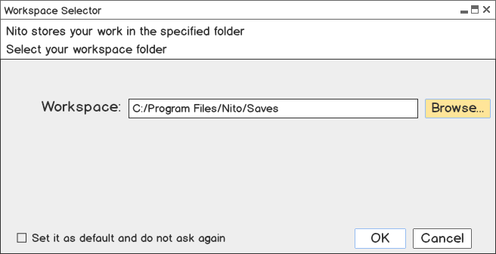
Administrator Interface Workspace Selection
Admin chooses a workspace for saving their work
Notes:
Ziya

Slide 9
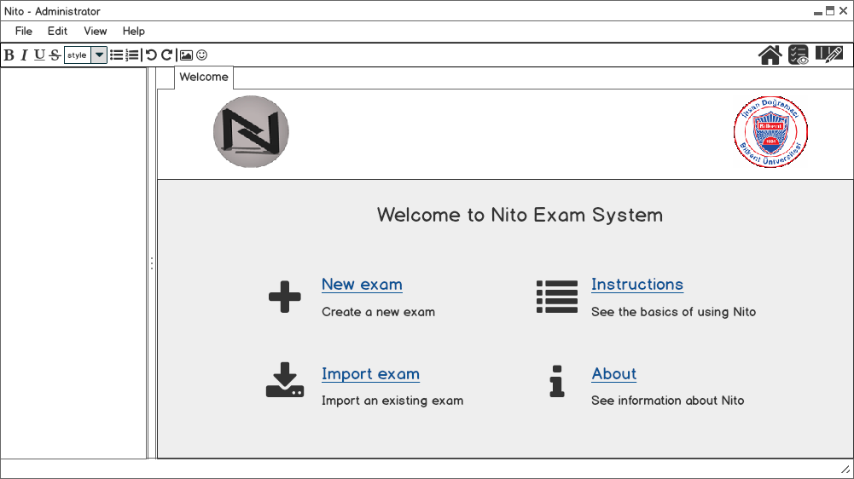
Administrator Interface Welcoming
Opening application for the first time shows Welcome page for quick start
Notes:
Ziya

Slide 10
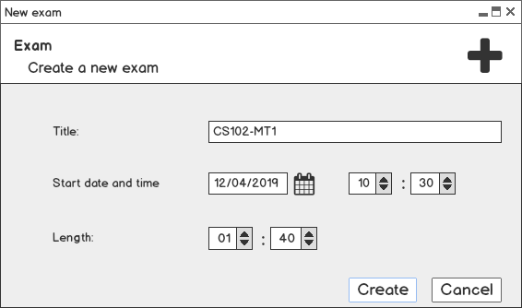
Administrator Interface New Exam Creation
Setting the exam title, date/time and length
Notes:
Ziya

Slide 11
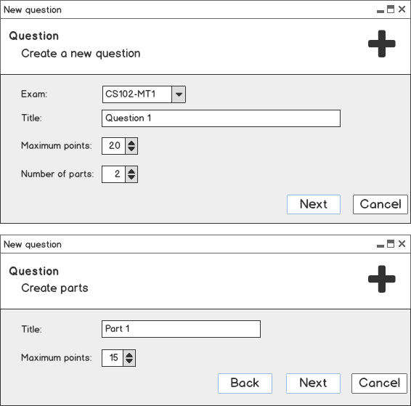
Administrator Interface New Question Creation
Admin can choose the exam, specify title, points and number of parts of the question
Then, admin creates each part by filling in the title and points
Exam instructions, criteria, templates can be added similarly
Notes:
Ziya

Slide 12
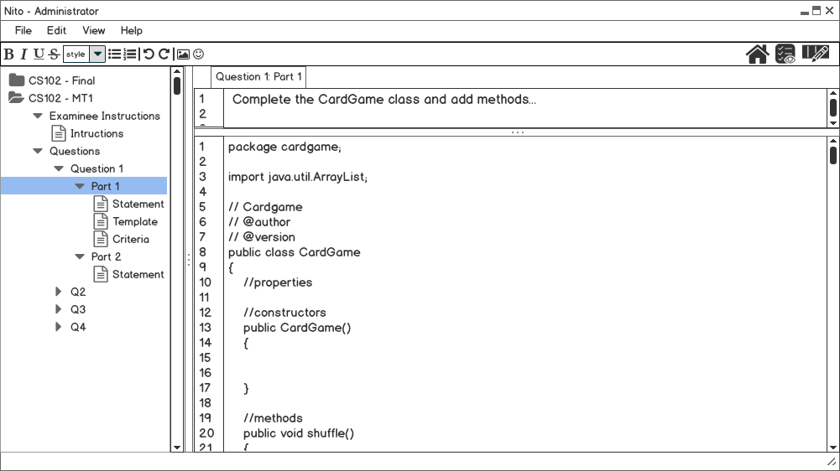
Administrator Interface Main Preparation Window
Multiple tab support
Adjustable pane sizes
Toolbar for quick access
Icons for navigation between home / monitoring / grading windows
Notes:
Ziya

Slide 13
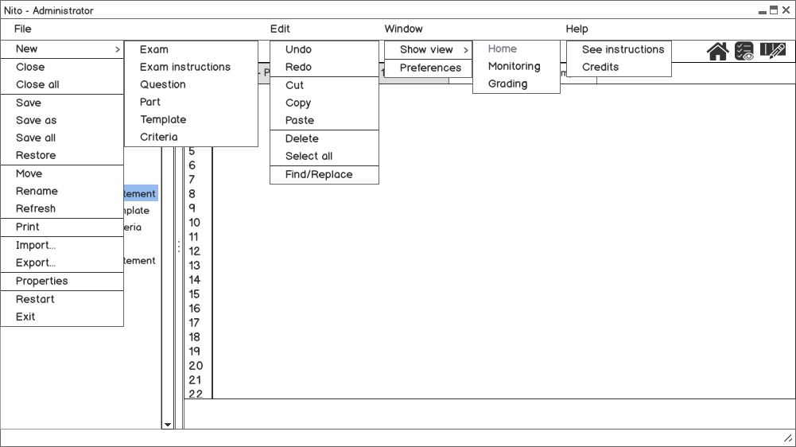
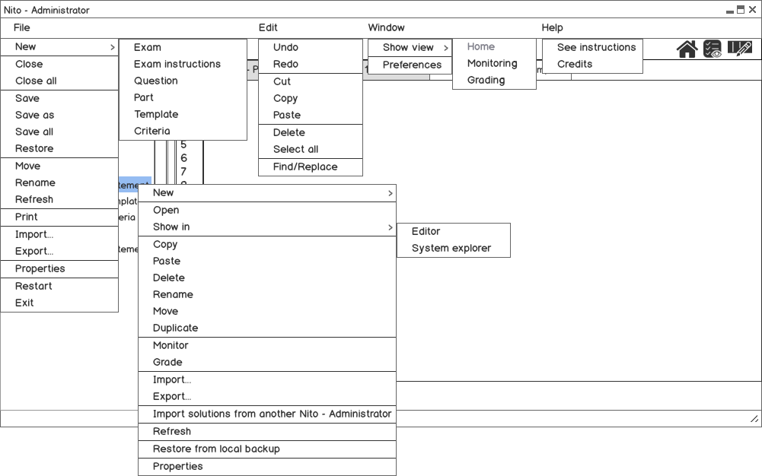
Administrator Interface Menus
Notes:
Mohi

Slide 14
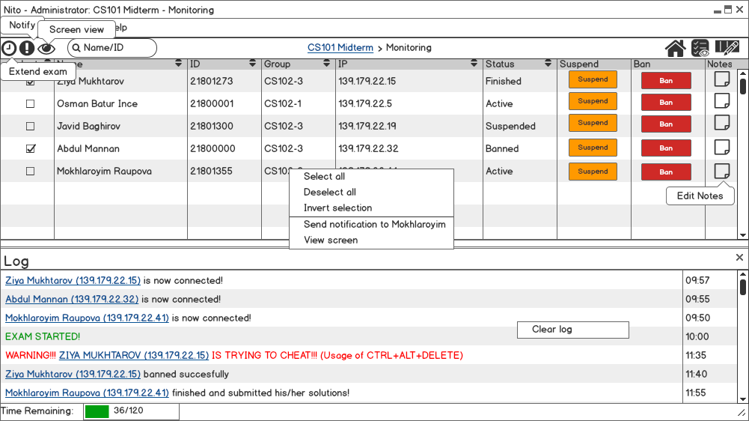
Administrator Interface Monitoring
The searchable list of all intended examinees along with their information
Options to ban, suspend and take notes
Color-coded log displaying important actions
Clicking name in log highlights it on table
Notes:
Adeem

Slide 15
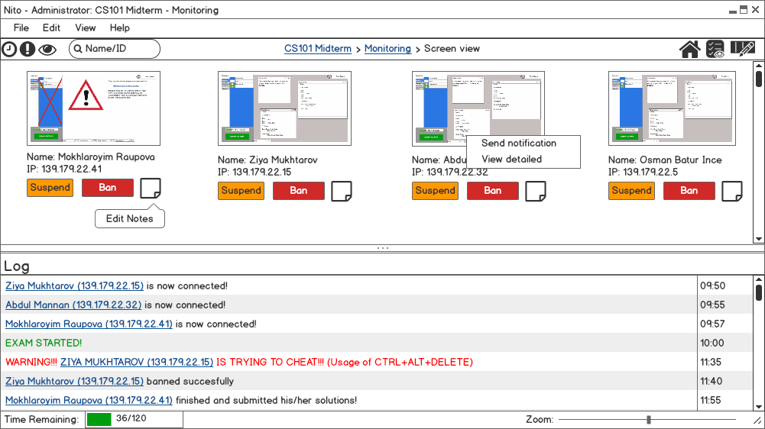
Administrator Interface Monitoring: Screen View
Admin can view all screens at once
Short details of examinees are shown under each of their screen view
Notes:
Adeem

Slide 16
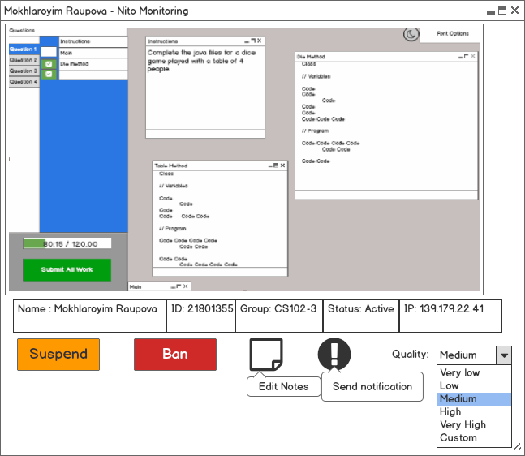
Administrator Interface Monitoring: Detailed View
Popup showing one particular screen view
Changing quality to prevent lagging
Notes:
Adeem

Slide 17
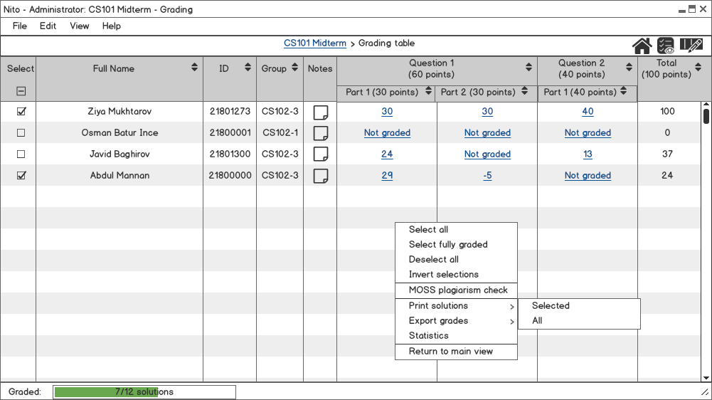
Administrator Interface Grading: Table View
Table showing examinees along with their information, notes taken during exam and current grades
Clicking on links opens main grading window of that examinee
Notes:
Sunny

Slide 18
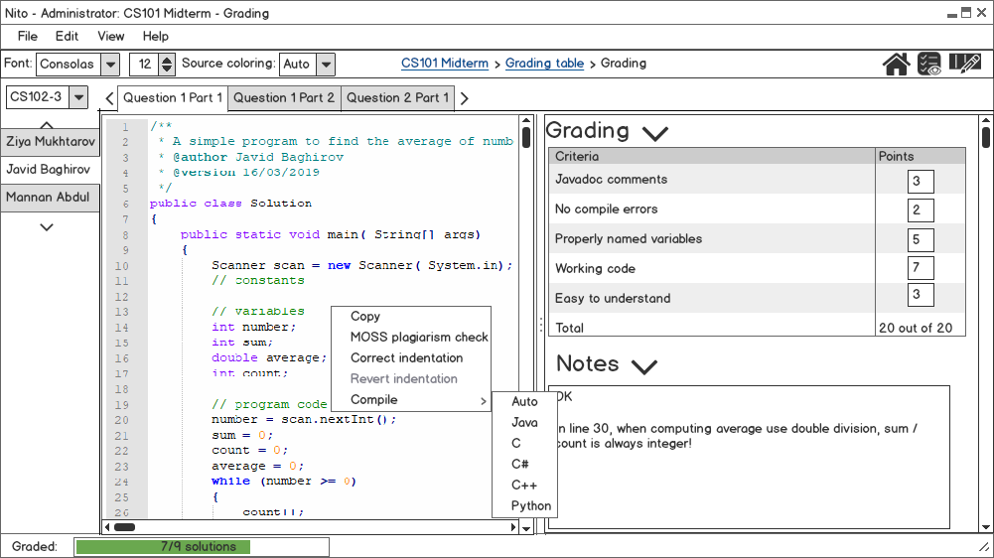
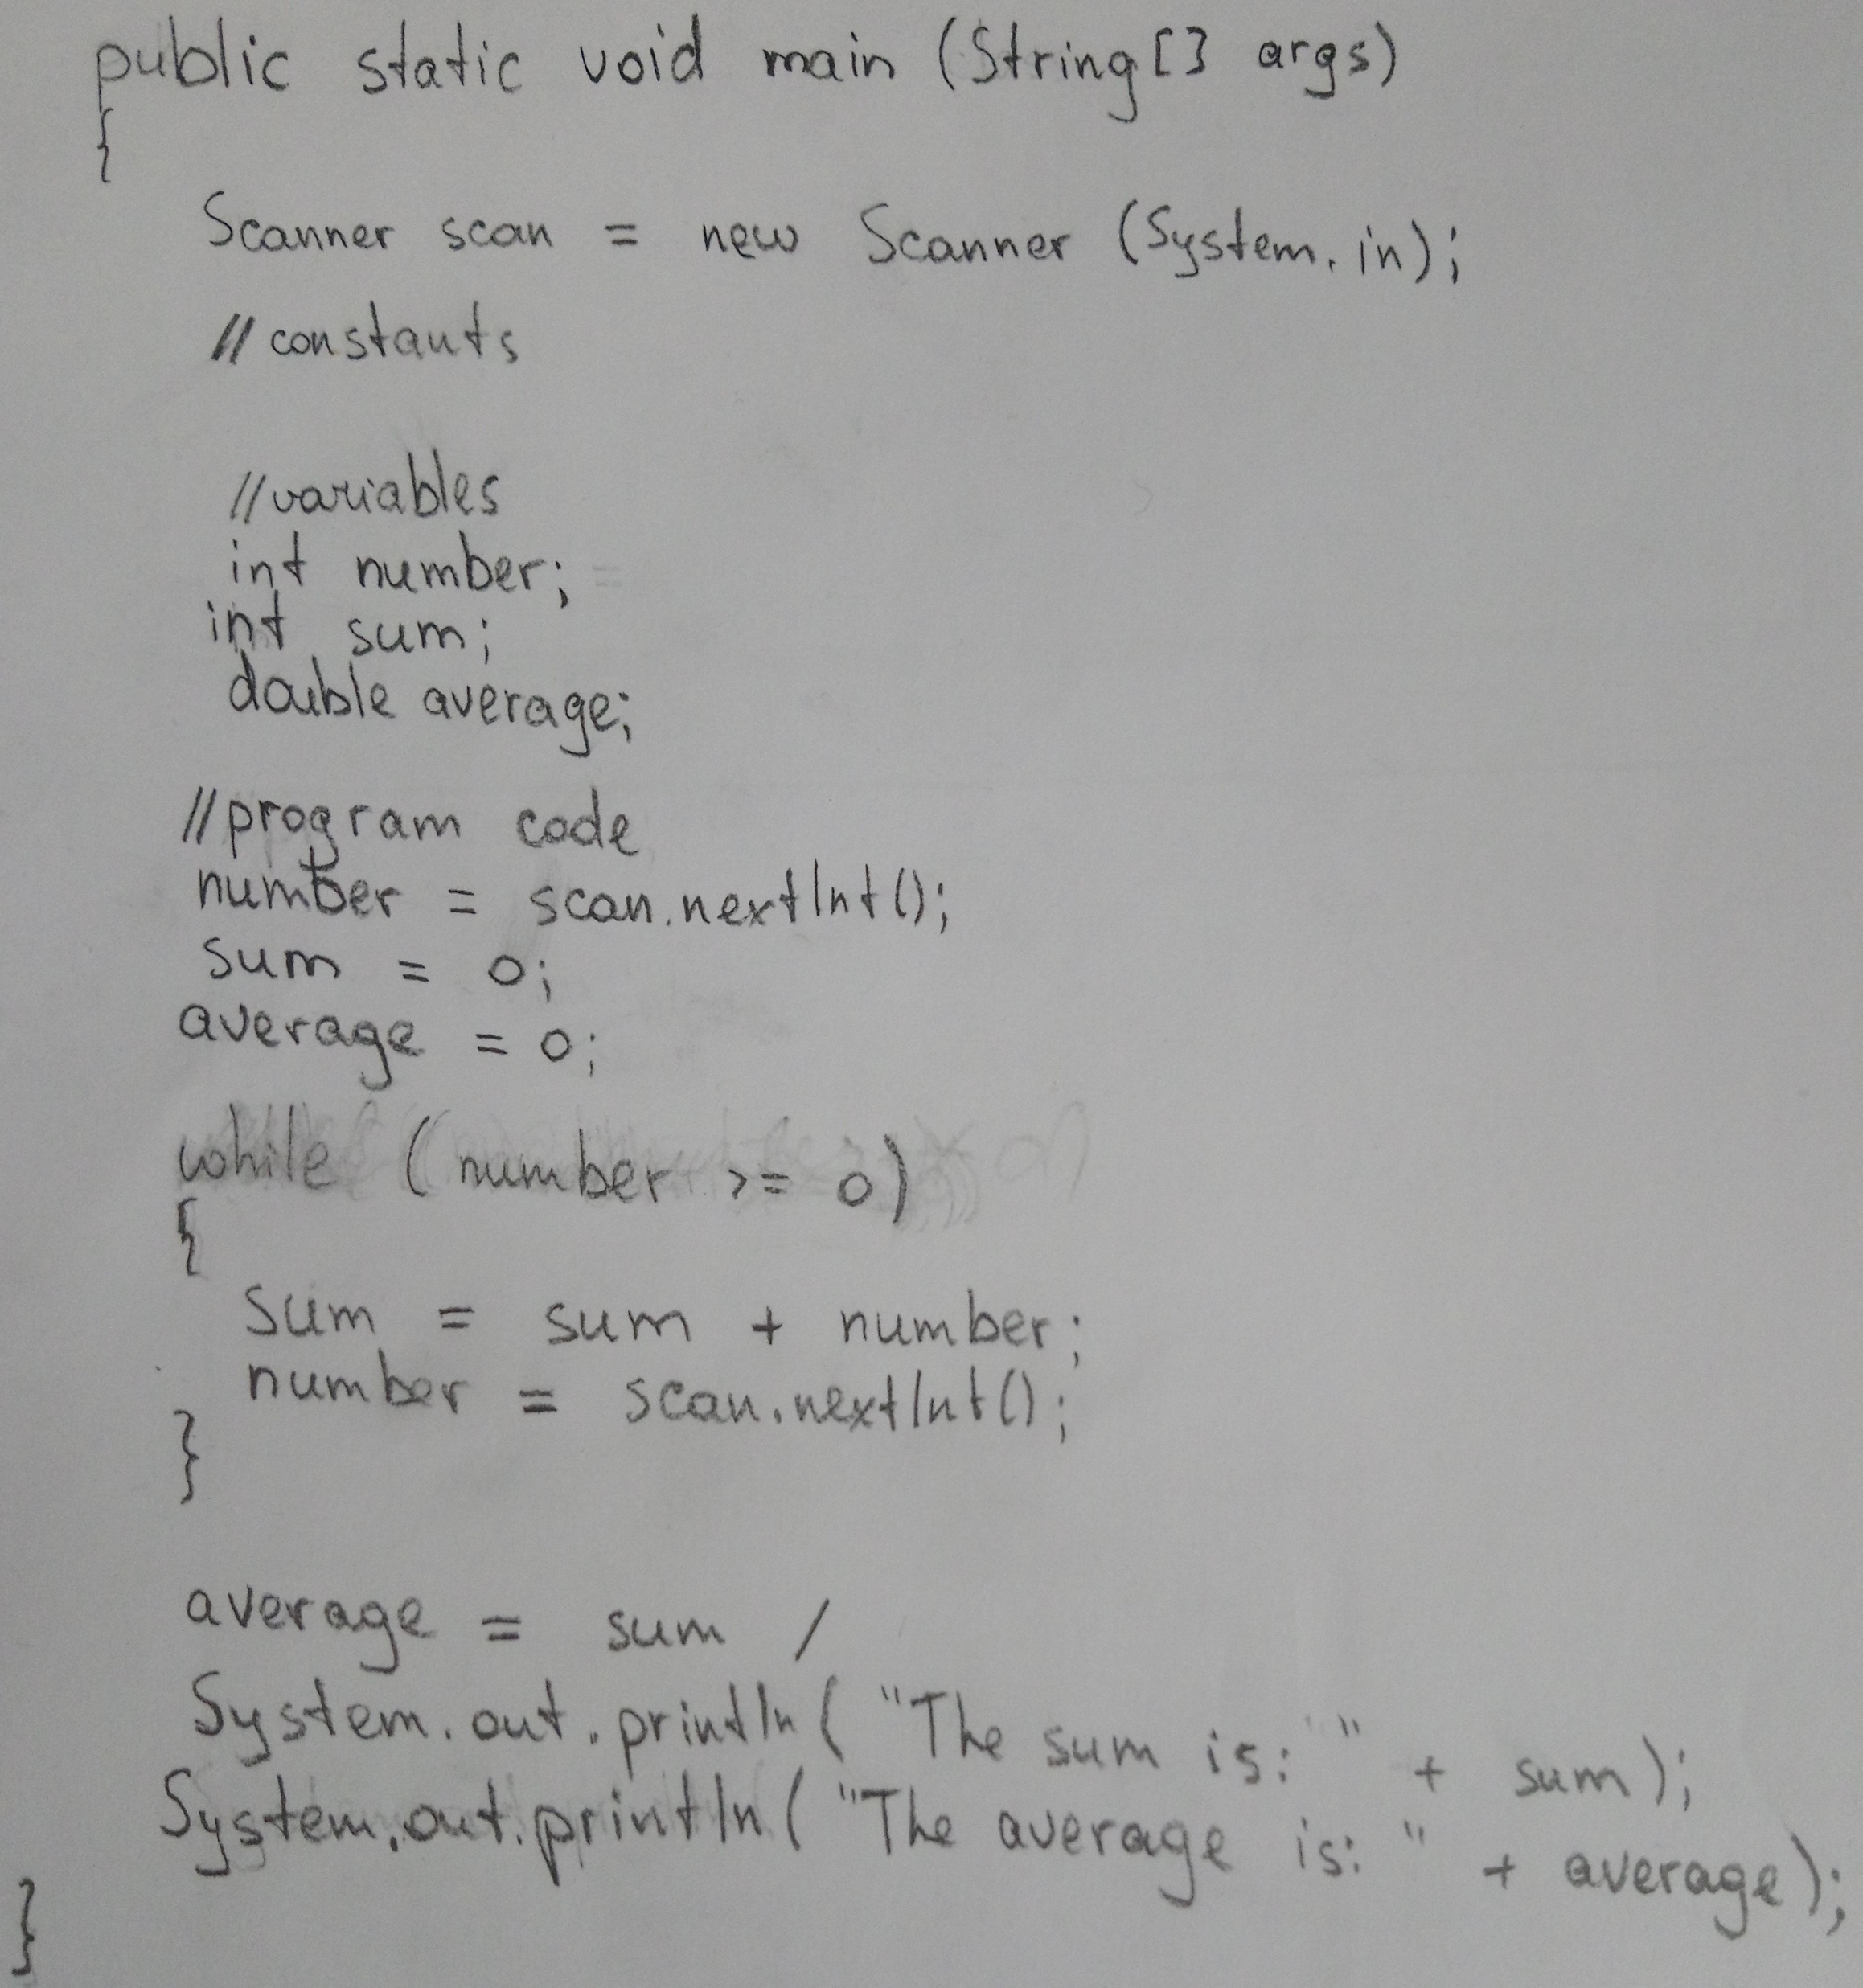
Administrator Interface Grading
Multiple tabs featuring selection of examinee and question part
Grouping can be used to hide irrelevant examinees
Criterion grading and note taking options
Optional syntax highlighting
Notes:
Sunny

Slide 19
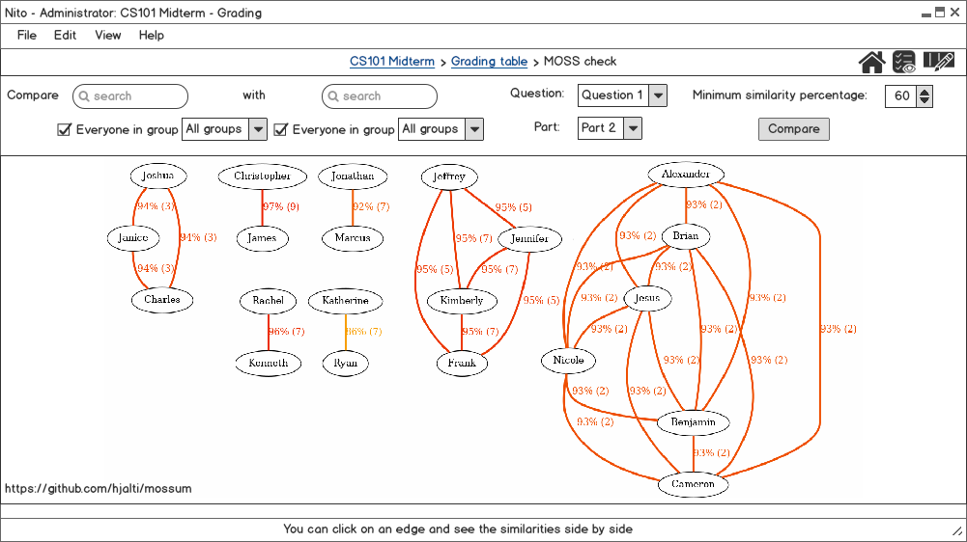
Administrator Interface Grading: MOSS Check
Option to check a group of examinees with each other and see the graph of similarity
Choosing specific question and part to be checked
Ability to see two solutions side by side
Notes:
Javid

Slide 20
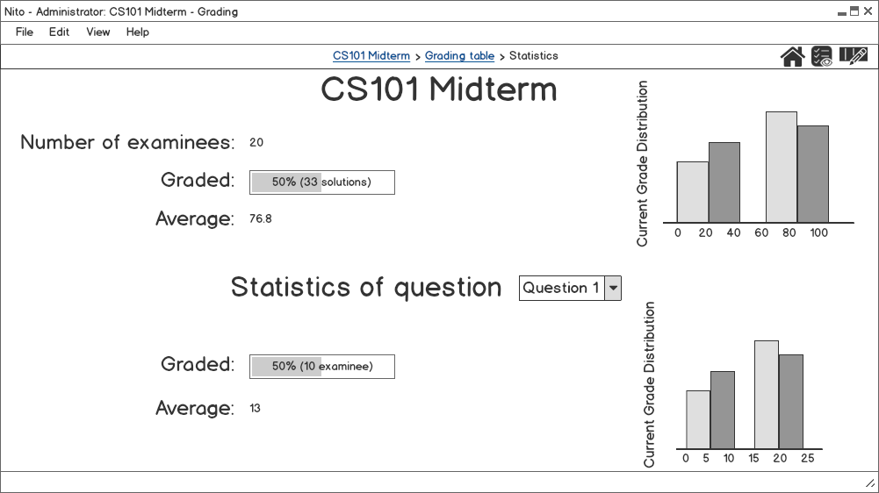
Administrator Interface Grading: Statistics
Shows statistics of the exam and the selected question such as number of examinees and average
Notes:
Javid

Slide 21



Do your best!
Notes:
Everyone

